Slide 1
UE18CS390A – Capstone Project Review #3
(High Level Design and Proposed Methodology)
Project Title : Intelligent Video Surveillance
Project ID : 9
Project Guide : Dr.Karthik Chandrasekhar
Project Team : Siddhant Kumar : PES2201800129
Ayushi Agarwal : PES2201800053
Aakash Bali : PES2201800035
Shivam Singh Rawat : PES2201800095

Slide 2
Outline
Abstract
Summary of Literature Survey
Suggestions from Review – 2
Proposed Methodology / Design Approach
Architecture
Design Description
Technologies Used
Project Progress
References

Slide 3
Abstract
Well defined problem statement.
Surveillance of security video feeds manually is a laborious process where the reaction to a trigger event must be immediate. In the past few decades, surveillance cameras, also known as Closed-circuit television (CCTV), have had a rapid growth in numbers around the world. Surveillance security is a very tedious and time-consuming job.

Slide 4
Abstract
Provide a basic introduction of the project
In this project, we aim to build a system to automate the task of video surveillance. We will analyze the video and identify the abnormal activities such as violence and theft and trigger necessary actions. The main area of focus are health issues(like cardiac arrest),detect violence and find any suspicious objects.
This can be easily incorporated at public places and data collected through CCTV can then be fed into the system to generate history of abnormal events occuring during the course of time.

Slide 5
Literature Survey
Paper Details | Objective of paper, Techniques/Methods | Advantages | Limitations
Intelligent video surveillance: a review through deep learning techniques for crowd analysis by G. Sreenu | The main objectives identified which illustrate the relevance of the topic are listed out below. 1. Continuous monitoring of videos is difficult and tiresome for humans. 2. Intelligent surveillance video analysis is a solution to laborious human task. 3. Intelligence should be visible in all real world scenarios. 4. Maximum accuracy is needed in object identification and action recognition. 6. Time taken for response generation is highly important in real world situation. 7. Prediction of certain movement or action or violence is highly useful in emergency situation like stampede. 8. Availability of huge data in video forms. | The paper includes a deep rooted survey which starts from object recognition, action recognition, crowd analysis and finally violence detection in a crowd environment. | The methods reviewed in above sections are good in automatic feature generation. All methods are good in handling individual entity and group entities with limited size.

Slide 6
Literature Survey
Paper Details | Objective of paper, Techniques/Methods | Advantages | Limitations
A deep learning approach to building an intelligent video surveillance system by Jie Xu | FaceNet with Multi-task Cascaded Convolutional Networks (MTCNN) achieves higher accuracy than advances such as DeepFace and DeepID2+ while being faster. | Deep-learning methods are easier to deploy and possess better scalability than conventional machine-learning methods. Capable of learning more complex features by taking advantage of multiple levels of representation. These features are learned systematically rather than designed manually by humans. | To train the model on high- quality image sequences, especially when images captured by the surveillance camera are of high quality as well. The best face recognition accuracy is achieved by training on a mixture of as many static images and image sequences as possible, the accuracy would probably not suffer too much if only a single type of images are available for training.

Slide 7
Literature Survey
Paper Details | Objective of paper, Techniques/Methods | Advantages | Limitations
A Systematic Review of Intelligence Video Surveillance: Trends, Techniques, Frameworks, and Datasets by Guruh Fajar Shidik | To provide and propose a concept of framework that can be integrated and classified based on the corresponding articles.To present recommendations for the development of surveillance system researches upon the completion of this review, SLR to answer RQ. | This reviewed through many research papers related to surveillance present online, showing research trends over the years and application areas,network architectures and frameworks,hence listing methods widely applied in such models | This only listed the methods proposed over time but did not provide a detailed review of the techniques used but just summarised its application and was affected by illumination, camera movement and weather changes.

Slide 8
Literature Survey
Paper Details | Objective of paper, Techniques/Methods | Advantages | Limitations
SIAT: A Distributed Video Analytics Framework for Intelligent Video Surveillance by Md Azher Uddin | The objective of the paper is to come up with an effective way to scale-up intelligent video surveillance. It proposes a distributed video surveillance framework known an SIAT. The proposed framework is able to process both real time video streams and batch video analytics | SIAT exploits state-of-the-art distributed computing technologies with the aim to ensure scalability, effectiveness and fault-tolerance. | This paper doesn’t address issues such as a cloud-based system, for example, resource utilization, Security and Privacy, and so forth.

Slide 9
Further Literature Survey
Paper Details | Objective of paper, Techniques/Methods | Advantages | Limitations
Video Anomaly Detection using Convolutional Spatiotemporal Autoencoder by Umesh Chandra Pati and Santos Kumar Das | The proposed video anomaly detection system is based on the intuition that the anomalous events will generate a high value of anomaly score (i.e., a low value of regularity score) as the trained model can’t reconstruct the anomalous frames efficiently.The methodology can be explained in three significant steps: preprocessing of data, representation learning for automatic feature extraction, and regularity score estimation form the reconstruction error. | A comparative analysis of the proposed method with the state-of-art is presented and the results are found to be promising. The training is carried out in end-to-end layer fashion only with the normal data classes.The problem of anomalous dataset scarcity is addressed with this type of semi-supervised learning approach. | This paper also doesn’t address issues such as a cloud-based system, for example, resource utilization, Security and Privacy, and so forth.

Slide 10
Further Literature Survey
Paper Details | Objective of paper, Techniques/Methods | Advantages | Limitations
Spatio-Temporal Encoder-Decoder Fully Convolutional Network for Video-based Dimensional Emotion Recognition by Zhengyin Du, Suowei Wu, Di Huang and Yunhong Wang | Extract contextual relation through integrating both low-level encoded and high-level decoded clues.Temporal Intermediate Supervision (TIS) is then introduced to enhance affective representations generated by TH-CNN under a multi-resolution strategy, which guides TH-CNN to learn macroscopic long-term trend and refined short-term fluctuations progressively. | Due to TH-CNN and TIS, knowledge learnt from the intermediate layers also makes it possible to offer customized solutions to different applications by adjusting the decoder depth. | The success of these features is strongly dependent on prior expertise, and cannot be guaranteed for incomplete human cognition. In general, such features are built within a relatively small and fixed temporal window and are incapable of capturing sufficient temporal contextual information.

Slide 11
Suggestions from Review - 2
Provide the suggestions and remarks given by the panel members.
The main feedback received by us from the panel members last time was you use image compression techniques to reduce dataset size for faster processing

Slide 12
Suggestions from Review - 2
Mention the feasibility on the same showing the progress.
For image compression, we have used INTERPOLATION_AREA method of OpenCV which compresses the images based on the area of the pixel.
Further, research needs to be done on more accurate and precise Linear Algebraic methods for image compression and optimizing the storage by incorporating methods such as Single Value Decomposition(SVD), Gaussian elimination, etc.

Slide 13
Design Details
Briefly describe all the platforms, systems, and processes that it depends on and comprise any vital changes that need to be made to them.
Below are some examples but it is not an exhaustive list:
Novelty, Innovativeness, Interoperability, Performance, Security, Reliability, Maintainability, Portability, Legacy to Modernization, Reusability, Application Compatibility.
Note: Applicable to Research project

Slide 14
Design Details
Novelty & Innovativeness: Since most of the process is automated and includes a variety of domains such as theft identification, violence detection, and detection of the chances of explosion to raise alarm in case of any suspicious or anomalous behaviour.
Interoperability & Portability: It is built using google colaboratory which makes it platform independent and hence is portable but basic hardware requirements need to be met in order to run the model efficiently.

Slide 15
Design Details
Performance & Application compatibility: The given model handles the huge amount of data and produces result in legitimate amount of time. Also it has most of the libraries required to run the model already available and also ensures capabilities to reuse many components thereby reducing much time in developing the project.
Maintainability: The software would be scheduled for regular software updates and would be updated with the latest algorithms that we come across and find fit for the situation where it is deployed.

Slide 16
Design Details
Security & Reliability: A security requirement that is a must is that there must not be fake cases being enacted or false alarms being triggered from the software which would make it a tedious task for the agencies and make the software a burden rather than a help. From a privacy perspective,the sensitive data will only be accessible by the security officials and the concerned authority.Each member of the concerned authority will have a unique UserID and Password to login and henceforth use this software.
Resource utilization: Our project requires a minimum/optimal amount of resources to run the project efficiently and effectively in terms of storage, libraries etc.

Slide 17
Design Details
Reusability: The results of previous images could be reused for the latter inference, they cache the results of previous frames to reduce redundant computation and latency.The data flow inside computing blocks and develops a data reuse scheme to alleviate the bandwidth burden in convolution layers.If the common data could be reused, it is not necessary to load all data to a new computing block. The data reuse is used to parallelise computing threads and accelerate the inference of a CNN model. A cache-based software accelerator for mobile continuous vision applications, which reuses the computation of similar image regions to avoid unnecessary computation and saves resources on mobile devices.

Slide 18
Proposed Methodology / Approach
Details of the new approach- benefits/drawbacks
We will be using a spatiotemporal autoencoder for 3D convolution network which applies deep neural networks to 3-dimensional space for learning spatio-temporal features of the video feed
The encoder part extracts the spatial and temporal information, and then the decoder reconstructs the frames. The abnormal events are identified by computing the reconstruction loss using Euclidean distance between original and reconstructed batch.

Slide 19
Benefits of the approach
A ConvNet is able to successfully capture the Spatial and Temporal dependencies in an image through the application of relevant filters. The architecture performs a better fitting to the image dataset due to the reduction in the number of parameters involved and reusability of weights. In other words, the network can be trained to understand the sophistication of the image better.

Slide 20
Benefits of the approach
An autoencoder can learn non-linear transformations with a non-linear activation function and multiple layers. It doesn't have to learn dense layers. It can use convolutional layers to learn which is better for video, image and series data.

Slide 21
Benefits of the approach
We have chosen LSTM over alternative ,hidden Markov models and other sequence learning methods because of its relative insensitivity to gap length. What that means is if we want to predict the sequence after 1,000 intervals instead of 10, the model will forgot the starting point by the time it reaches the intervals towards the end but LSTM remembers .

Slide 22
Benefits of the approach
The pre-processing required in a ConvNet is much lower as compared to other classification algorithms. While in primitive methods filters are hand-engineered, with enough training, ConvNets have the ability to learn these filters/characteristics.

Slide 23
Drawbacks of the approach
Autoencoders are not that efficient compared to Generative Adversarial Networks in reconstructing an image. As the complexity of the images increase, autoencoders struggle to keep up and images start to get blurry

Slide 24
Drawbacks of the approach
Convolutional Neural networks (CNN) have great performance while classifying images which are very similar to the dataset . However, If the images contain some degree of tilt or rotation then CNNs usually have difficulty in classifying the image

Slide 25
Drawbacks of the approach
LSTM’s require a lot of resources and time to get trained and become ready for real-world applications. In technical terms, they need high memory-bandwidth because of linear layers present in each cell which the system usually fails to provide for. Thus, hardware-wise, LSTMs become quite inefficient.

Slide 26
Architecture (if applicable)
Provide high-level design view of the system.
Identify the logical user groups, application components, data components, and interfacing systems. Illustrate the collaboration and interaction between the major components.

Slide 27
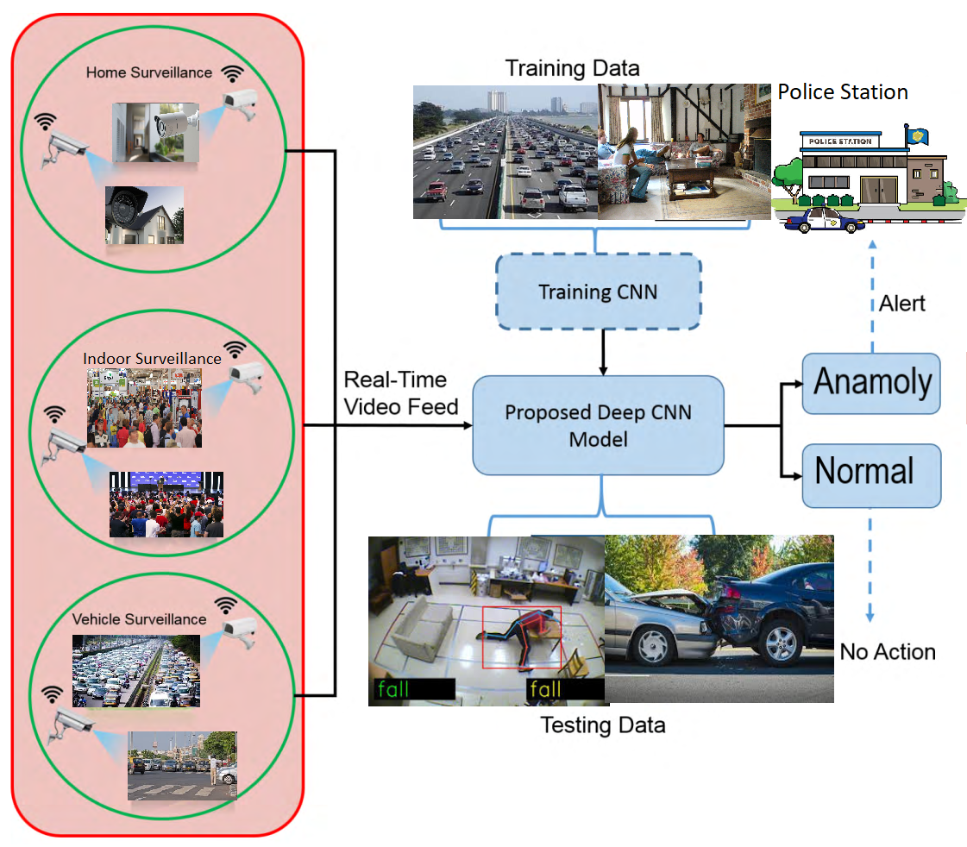
Architecture (if applicable)

Slide 28
Architecture (if applicable)
The data components of this project will be the dataset used for the model and user credentials which will authenticate the user to the model
Application components consists of convolution neural networks and spatiotemporal autoencoder
Interfacing system includes the website, built using HTML, CSS ,JS and Flask
Collaboration and interaction is same as shown in the previous diagram.

Slide 29
Design Description
Add as many slides as required to cover the following aspects:
Master class diagram
ER Diagram
User Interface Diagrams/ Use Case Diagrams
Report Layouts
External Interfaces

Slide 30
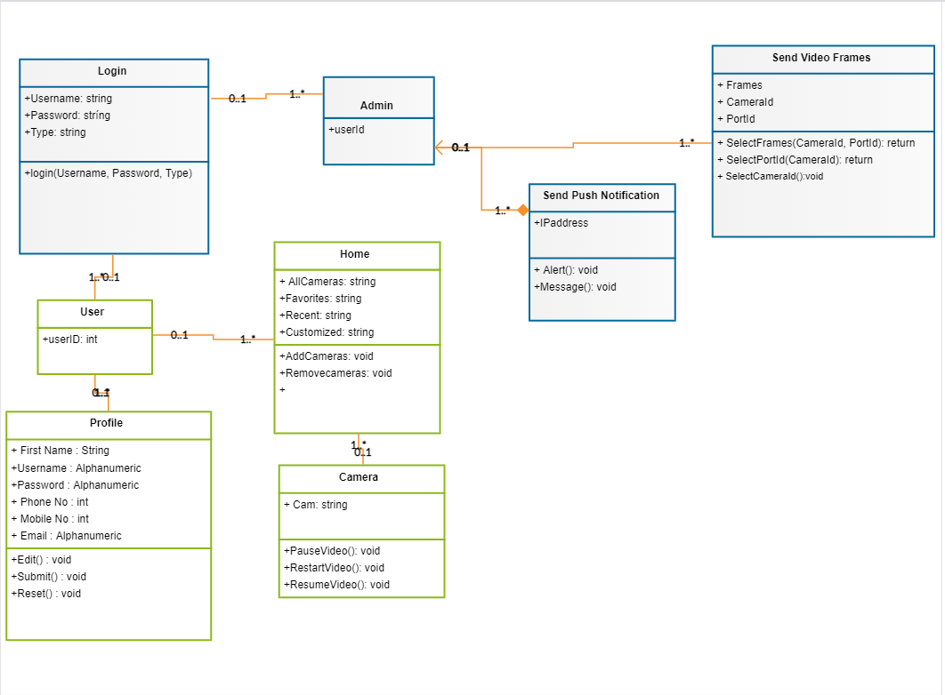
Master Class Diagram

Slide 31
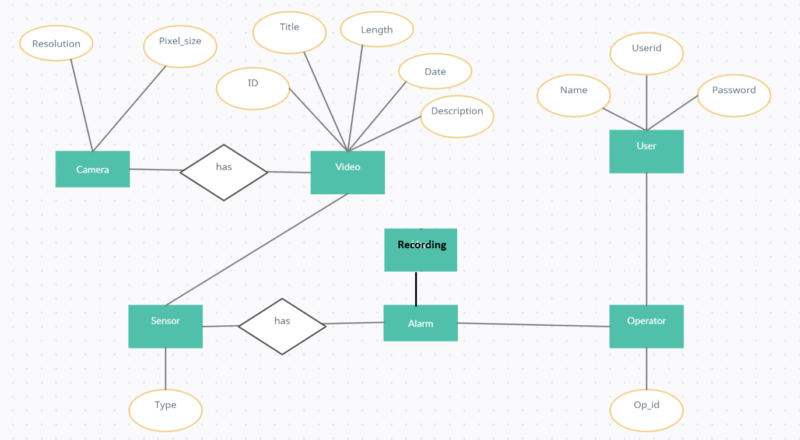
ER Diagram

Slide 32
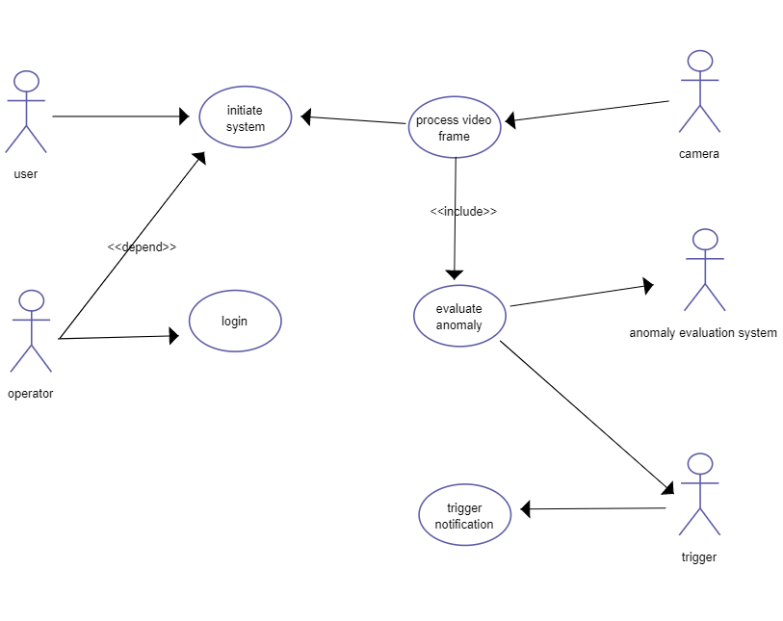
User Interface Diagrams/ Use Case Diagrams

Slide 33
Technologies Used
Convolutional Neural Network :
A Convolutional Neural Network (ConvNet/CNN) is a Deep Learning algorithm which can take in an input image, assign importance (learnable weights and biases) to various aspects/objects in the image and be able to differentiate one from the other.

Slide 34
Technologies Used
Long Short Term Memory :
An artificial recurrent neural network (RNN) architecture used in the field of deep learning. It remembers values over arbitrary intervals. LSTM is well-suited to classify, process and predict time series given time lags of unknown duration.

Slide 35
Technologies Used
Spatio-Temporal Autoencoder:
An Autoencoder is a neural network trained by backpropagation and provides an alternative to PCA to perform dimensionality reduction by reducing the reconstruction error on the training set.
The characteristics of autoencoders are useful in image processing.One example can be found in lossy image compression, where autoencoders outperformed other approaches and proved competitive against JPEG 2000

Slide 36
Project Progress
What is the project progress so far?
What is the percentage completion of the project?
The project so far is the design of the user interface of the application and the pre-processing of the video stream into frames that would be fed to the application and it’s storage.
The project is 45% completed as of this date with the implementation+training of the algorithm with the linking of the back-end to the interface pending.

Slide 37
Capstone (Phase-I & Phase-II) Project Timeline
Provide
The timelines for execution of the project through Gantt chart.
The plan in terms of efforts by individuals in the team.
Mention the tasks involved in different stages.

Slide 38
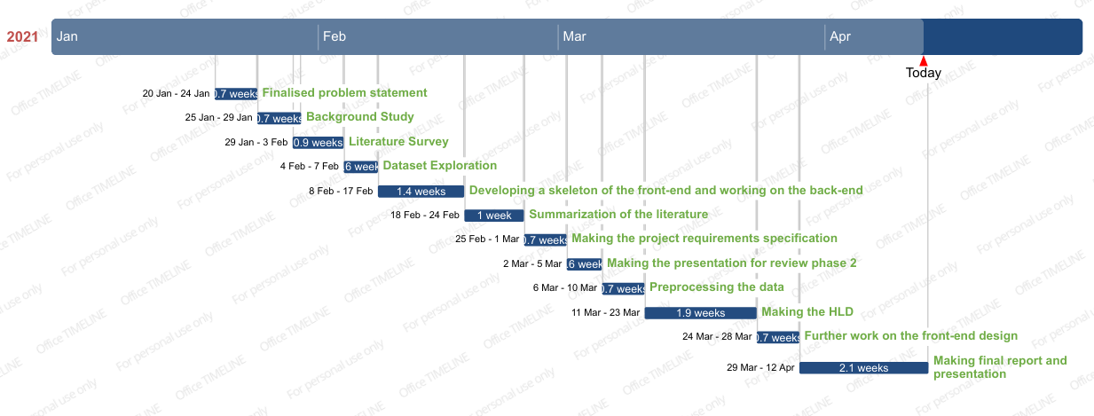

Slide 39
Conclusion
Summarize the key points.
We will be using convolutional LSTM in CNN for anomaly detection
The front-end is web based made by HTML,CSS,JS and will be integrated with the backend using flask.
Various decisions made in the project were justified in the previous slides.
The project is 45% completed and will provide major look and feel of the upcoming product

Slide 40
References
Provide references pertaining to your research according to IEEE format.
1.Kardas K, Cicekli NK. SVAS: surveillance video analysis system. Expert Syst Appl. 2017;89:343–61.
2. Wang Y, Shuai Y, Zhu Y, Zhang J. An P Jointly learning perceptually heterogeneous features for blind 3D video
quality assessment. Neurocomputing. 2019;332:298–304 (ISSN 0925-2312).
3. Tzelepis C, Galanopoulos D, Mezaris V, Patras I. Learning to detect video events from zero or very few video examples.
Image Vis Comput. 2016;53:35–44 (ISSN 0262-8856).

Slide 41
References
4. Fakhar B, Kanan HR, Behrad A. Learning an event-oriented and discriminative dictionary based on an adaptive
label-consistent K-SVD method for event detection in soccer videos. J Vis Commun Image Represent.
2018;55:489–503 (ISSN 1047-3203).
5. Luo X, Li H, Cao D, Yu Y, Yang X, Huang T. Towards efficient and objective work sampling: recognizing workers’
activities in site surveillance videos with two-stream convolutional networks. Autom Constr. 2018;94:360–70 (ISSN
0926-5805).

Slide 42
Thank You

